Slide 1
NPK Detection and Inventory Management System
Fundamentals of Python Programming and SQL
Presenters:
JATIN SATANI (202319021)
DEEP RABADIYA (202319029)
Under Guidance of:
DR. AMIT MANKODI

Slide 2
Objective of the project :
Implement a system for analyzing soil nutrient levels (N, P, K) based on historical data (2003-2007).
Provide personalized fertilizer recommendations based on soil nutrient levels.
Manage fertilizer stock.
Reason for choosing this project:
Provide farmers with actionable insights into soil composition to enhance decision-making for fertilizer application.
Assist farmers in optimizing nutrient supply, contributing to improved agricultural productivity.
Ensure farmers have timely access to an adequate supply of fertilizers, addressing logistical challenges.

Slide 3
Project Scope :
Functionalities:
Soil Nutrient Analysis: Determine NPK levels based on historical data.
Fertilizer Recommendation: Provide personalized fertilizer recommendations.
Inventory Management: Fertilizer stock for timely replenishment.
Scalability: Design the system for future enhancements.

Slide 4
Assumptions:
Data Accuracy: Assumes accuracy of historical data (2003-2007) for nutrient levels.
User Input: Assumes users provide accurate and representative data for analysis.
Out-of-Scope Functionalities:
Real-Time Data: Real-time nutrient analysis is out of scope for this version.
Physical Soil Testing: The system does not replace laboratory soil testing; it complements by providing estimates.
Weather Impact: The system does not incorporate real-time weather data for analysis.

Slide 5
Topics Covered in Project Implementation
Data Handling:
- Utilization of file handling for reading and processing CSV data (`open`, `readlines`, `split`).
Data Structures:
- Usage of dictionaries to structure and organize data (`{key: value}` pairs).
Control Structures:
- Implementation of conditional statements (`if`, `elif`, `else`) for decision-making.
- Use of loops (`for`) for iterating through data and repetitive tasks.
Functions:
- Definition and implementation of functions to encapsulate specific tasks.
- Functions for nutrient calculation, rating determination, and fertilizer recommendation.

Slide 6
Input/Output Handling:
- Utilization of user input (`input` function) for personalized data processing.
- Presentation of results through the console (`print` statements).
File Handling:
- Reading data from external CSV files (`open`, `readlines`, `split`).
- Writing data to a new CSV file (`open`, `write`).
Exception Handling:
- Basic error handling for scenarios like invalid user input.

Slide 7
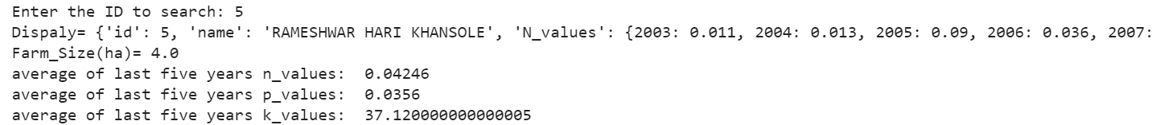
Key Functionalities
User Data Display:
def display():
user_id = int(input("Enter the ID to search: "))
id_found = False
for item in data:
if user_id == item['id']:
id_found = True
x = item
print('Display=', x)
# ... (rest of the code)

Slide 8
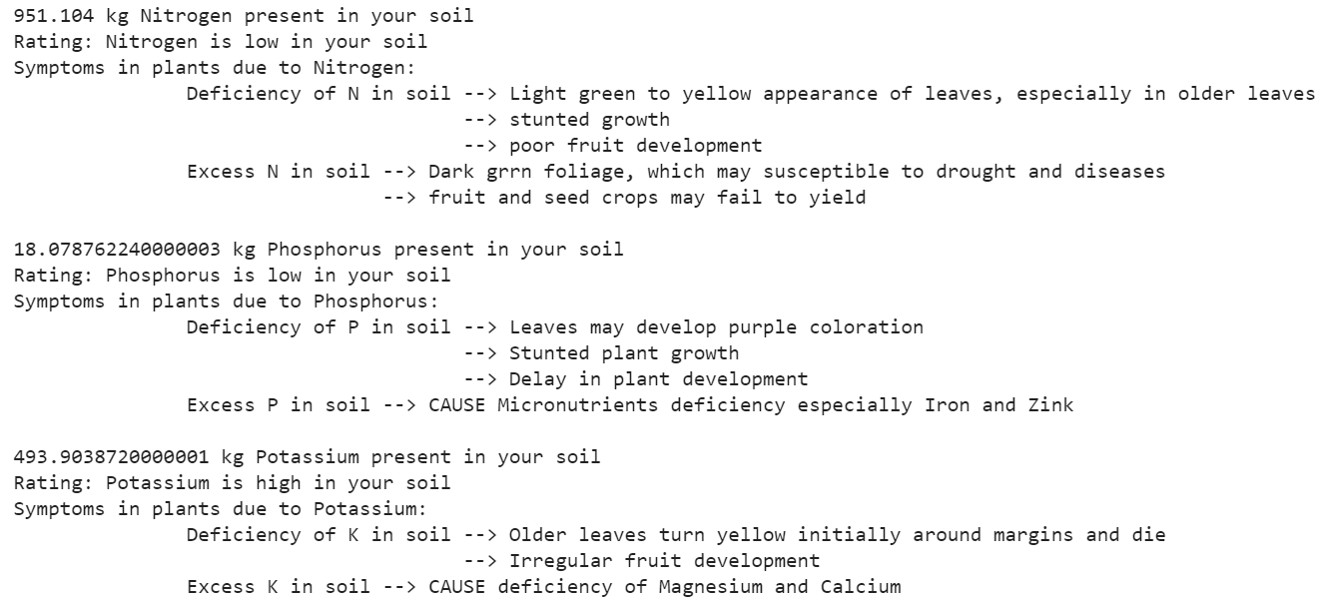
Nutrient Calculation and Rating:
def Nitrogen_calculation():
Kg_N_in_soil = Average_n * 10000 * 2.24
return Kg_N_in_soil
def Nitrogen_rating():
if Kg_Nitrogen < 1200:
print('Rating: Nitrogen is low in your soil')
elif 1200 < Kg_Nitrogen < 2400:
print('Rating: Nitrogen is medium in your soil')
else:
print('Rating: Nitrogen is high in your soil')

Slide 9

Fertilizer Recommendation:
def Urea_recommendation():
if Kg_Nitrogen < 1200:
print('Recommendation: Add 326 kg urea Fertilizer per hectare in your soil')
elif 1200 < Kg_Nitrogen < 2400:
print('Recommendation: Add 261 kg urea Fertilizer per hectare in your soil')
else:
print('Recommendation: Add 196 kg urea Fertilizer per hectare in your soil')

Slide 10
Fertilizer Purchase Process:
def buy():
global f_Urea, f_SSP, f_MOP, urea, ssp, mop
# ... (rest of the code)
# Call the buy function to initiate the purchase process
buy()

Slide 11
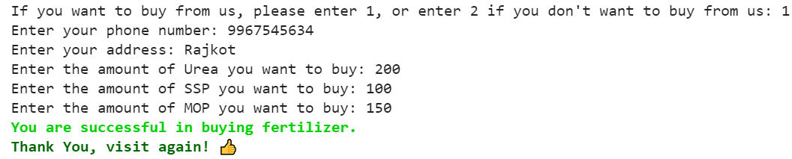
Inventory Management:
def fertilizer():
global f_Urea, f_SSP, f_MOP
f_file = open('/content/fertilizer.csv', 'r')
f = f_file.readlines()
# ... (rest of the code)

Slide 12
Conclusion:
- The NPK Detection and Inventory Management System efficiently analyzes soil nutrient levels.
- Provides insightful nutrient deficiency/excess information to farmers.
- Offers personalized fertilizer recommendations based on nutrient levels.

Slide 13
Future Work:
1. Mobile Application:
- Develop a mobile app for easy accessibility, allowing farmers to check and manage soil data on the go.
2. Machine Learning Integration:
- Explore machine learning algorithms for more accurate nutrient predictions and personalized recommendations.
3. Expand Crop Database:
- Include a broader range of crops to enhance the system's applicability across different agricultural scenarios.
4. Real-time Sensor Integration:
- Integrate real-time soil sensors for live nutrient data, ensuring up-to-date recommendations.

Slide 14
Lessons Learned:
1. Data Handling :
- Dealing with CSV data.
- Gained experience in extracting and structuring data for analysis.
2. User Input Validation:
- Learned to guide users through correct inputs to avoid errors.
3. Fertilizer Recommendation Logic:
- Developed logic for fertilizer recommendations based on nutrient levels.
- Balanced recommendations with available stock and user demands.

Slide 15
5. User Interface Design:
- Considered user experience in designing the input and output interfaces.
- Recognized the importance of clear and user-friendly displays.
6. Continuous Improvement:
- Acknowledged the need for ongoing system updates and improvements.
- Emphasized the importance of adaptability in a dynamic project environment.
7. Real-world Application:
- Understood the practical applications of programming in agriculture.
- Recognized the potential impact of technology on optimizing farming practices.

Slide 16
Thank You

